Slide 1
ENGR 101
Introduction to Programming
Week 3

Slide 2
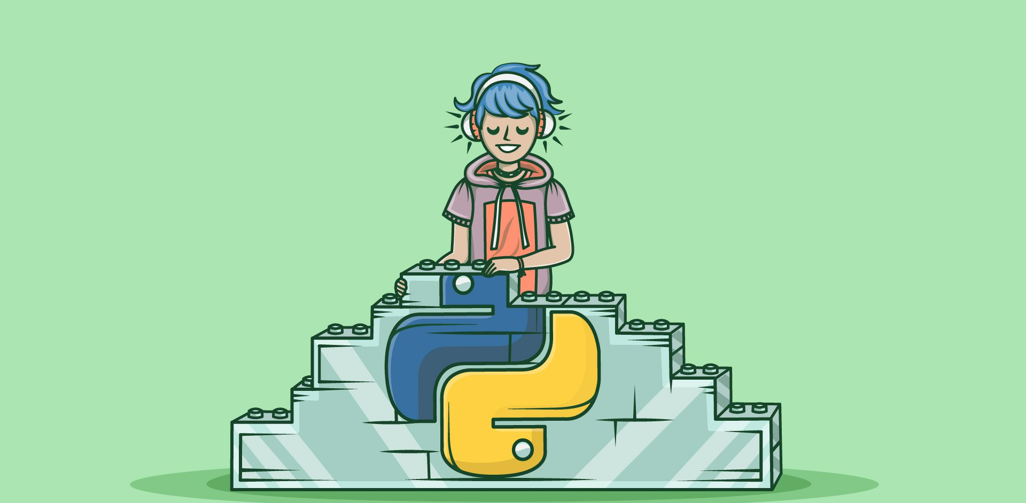
Python Dirty Hands Society
improve your programming skills
solve problems and build projects
learn more about Python
prepare for your mini projects
competitions and prizes
Meets on Fridays
16:00 – 17:30
Student Center
#K101

Slide 3
Reminder of Week 2
Variables, expressions and statements
Functions

Slide 4
Functions
Arguments, Local variables
first & last are arguments of the function student
full is a local variable inside the function student
def student(first,last):
full = first + ‘ ’ + last
print_twice(full)
name1 = ‘red’
name2 = ‘kit’
student(name1, name2)
print full

Slide 5
Type conversion
>>> int("32’) 32
>>> int(‘hello’) ERROR
>>> int(‘2.39’) ERROR
>>> float(32) 32.0
>>> str(32.45) ‘32.45’

Slide 6
Math functions
>>> import math
in order to access one of the functions defined in the math module, you need to use the dot notation.
>>> math.sqrt(4)

Slide 7
Composition
Wherever you can put a value, you can put an arbitrary expression.
>>> x = math.sin(degrees/360.0 * 2 * math.pi)
EXCEPT: The left hand side of an assignment!

Slide 8
WEEK 3
Functions, Iterations

Slide 9
How to train your turtle?
TurtleWorld

Slide 10
TurtleWorld
Install swampy package in Pycharm
File/Settings/Project Interpreter : +Add the package

Slide 11
TurtleWorld
Several turtle-steering functions:
  fd(a_turtle, x): move a_turtle forward x units
  bk(a_turtle, x): move a_turtle backward x units
  lt(a_turtle, angle): make a_turtle turn left by angle
  rt(a_turtle, angle): make a_turtle turn right by angle
Each Turtle is holding a pen. If the pen is down, the Turtle leaves a trail when it moves.
  pu(a_turtle): make a_turtle’s pen up
  pd(a_turtle): make a_turtle’s pen down

Slide 12
TurtleWorld
# import everything in TurtleWorld module in swampy package
from swampy.TurtleWorld import *
# build a world of turtles
world = TurtleWorld()
# maybe, a little turtle, Bob, is born here!
bob = Turtle()
# make the turtle screen stay on display until the user closes the window
wait_for_user()

Slide 13
TurtleWorld
from swampy.TurtleWorld import *
world = TurtleWorld()
bob = Turtle()
fd(bob,100) # move forward 100 units (pixels)
lt(bob, 90) # turn 90 degrees left
fd(bob,100) # move forward 100 units (pixels)
# make the turtle screen wait
wait_for_user()

Slide 14
TurtleWorld
Modify the program to draw a square.

Slide 15
TurtleWorld
Modify the program to draw a square.
from swampy.TurtleWorld import *
world = TurtleWorld()
bob = Turtle()
print bob
fd(bob,100) # first edge
lt(bob) # turn 90 degrees to left
fd(bob,100) # second edge
lt(bob)
fd(bob,100) # third edge
lt(bob)
fd(bob,100) # fourth edge
lt(bob)
wait_for_user() # keep the user interface open

Slide 16

Loops Explained
Invited Speaker: Mark Zuckerberg

Slide 17
Simple Repetition
for i in range(4):
print ‘Hello’
Hello!
Hello!
Hello!
Hello!
Use a for loop to draw the square.

Slide 18

for loop – syntax
0 by default
1 by default
for i in range(start, stop, step):
print i
Indentation
Have to be specified

Slide 19
for loop – different flavors
for i in range(start=0, stop, step=1):
# One parameter
for i in range(3):
print i
0
1
2
# Two parameters
for my_i in range(3, 6):
print my_i
3
4
5
# Three parameters
for i in range(4, 10, 2):
print i
4
6
8
# Going backwards
for i in range(0, -8, -2):
print i
0
-2
-4
-6

Slide 20
for loop – caveat
For the range function:
  All parameters have to be integers.
  Negative numbers are ok.
  Loop variable (e.g: i,k,etc.) naming → the same rules as in regular variables
for my_i in range(3, 6):
print my_i

Slide 21
TurtleWorld
Drawing a square with for loop
from swampy.TurtleWorld import *
world = TurtleWorld()
bob = Turtle()
print bob
for i in range(4):
fd(bob,100)
lt(bob)
wait_for_user()

Slide 22
Exercises
Work on Exercises in Section 4.3 (All of them)

Slide 23
Exercise 1
put your square-drawing code into a function definition.
call the function, passing the turtle as a parameter.
      # draw a square of size 100
      def square(t):
      for i in range(4):
      fd(t, 100)
      lt(t)
      square(bob)

Slide 24
Encapsulation
Encapsulation?
  Wrapping a piece of code up in a function
  e.g. Putting square-drawing code into a function
Benefits?
  You re-use the code. It is more concise to call a function twice than to copy and paste the body!
  Easy maintenance: Just need to modify the function definition. Function calls will directly be affected by the modification.

Slide 25
Encapsulation
# encapsulation demo
ray = Turtle()
square(ray)

Slide 26
Exercise 2
add a length parameter to the square function you developed.
# draw a square of a given length
def square(t, length):
for i in range(4):
fd(t, length)
lt(t)
square(bob, 100)

Slide 27
Generalization
Generalization?
  Adding a new parameter to a function (previous slide)
  Parametric rather than hard-coding
Benefits?
  It makes the function more general:
    In the square function (Exercise 1), the square is always the same size;
    In Exercise 2, it can be any size.

Slide 28
Generalization
Next step: instead of drawing squares, draw regular polygons with any number of sides.
# draw a polygon with n edges of a given size
def polygon(t, n, length):
angle = 360.0 / n
for i in range(n):
fd(t, length)
lt(t, angle)
# This draws a 7-sided polygon with side length 70.
polygon(bob,7, 70)

Slide 29
Generalization
If you have more than a few numeric arguments, it is easy to forget what they are, or what order they should be in.
It is legal, and sometimes helpful, to include the names of the parameters in the argument list:
polygon(bob, length=70, n=7)

Slide 30
Exercises

Slide 31
Exercise 3
Define a function that will take four digits (a, b, c, d), and print the number abcd divided by c.
For instance, when the input is 1, 2, 3, 5, it should print 1235/3 which is 411.
Below is a sample run:
>>> divide_by_10(1, 2, 3, 5)
>>>411

Slide 32
Exercise 4
Write a function print_even() that takes two even numbers as input and prints the all even numbers between these numbers.
Note: Use a for loop
For example:
print_even(12,18)
14
16

Slide 33
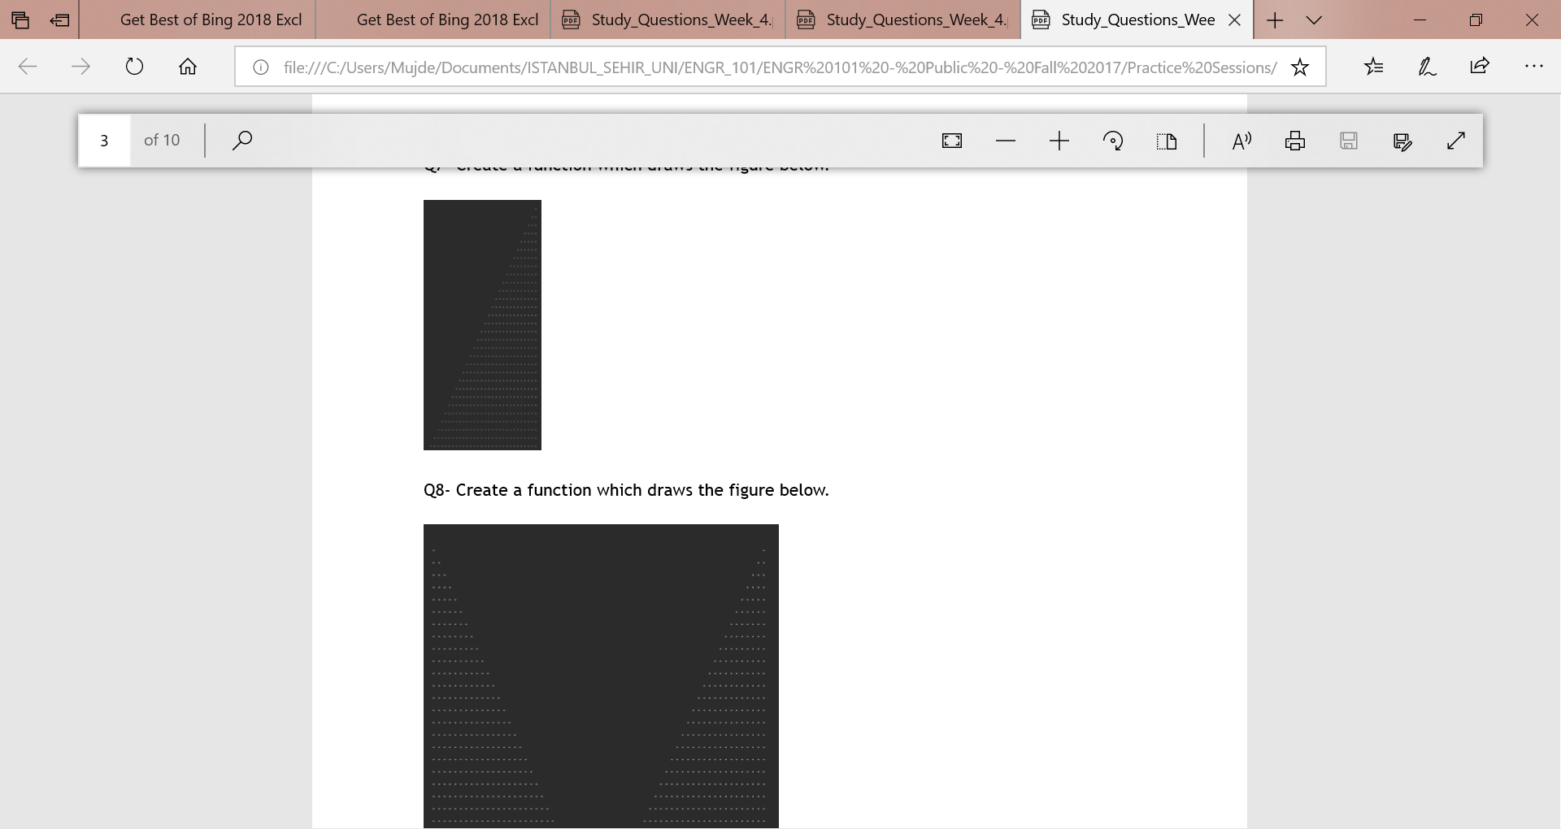
Exercise 5
Create a function which draws the figure below.

Slide 34
Exercise 6
Create letters M and U using our Turtle

